Slide 1


SIGHT CubeSat
Team-15
Department of Space Science and Engineering (DSSE), NCU, Taiwan
Chen, Han-Kun Su, Yin-Rui Kuan, Ching-Jui

Slide 2
Table of contents
01
02
STR & EPS
Mission Definition & System Architecture
03
04
Payload & GPS
OBC

Slide 3
01
Mission Definition & System Architecture

Slide 4
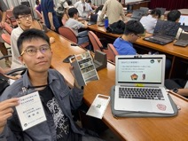


Team members
Chen, Han-Kun PM/STR/EPS
Su, Yin-Rui
OBC/Payload
Kuan, Ching-Jui
OBC/GPS

Slide 5



Mission Definition
Cultivate students' independent research and development ability
Measuring tropospheric science data
Verification technology and components

Slide 6
System Architecture
SIGHT CubeSat
STR
EPS
18650 battery
TP4056
Payload
BMP280
DHT22
GL300
OBC
Raspberry Pi
GPS 2
NEO 6M
Pi Camera
MPU6050

Slide 7
02
STR & EPS

Slide 8
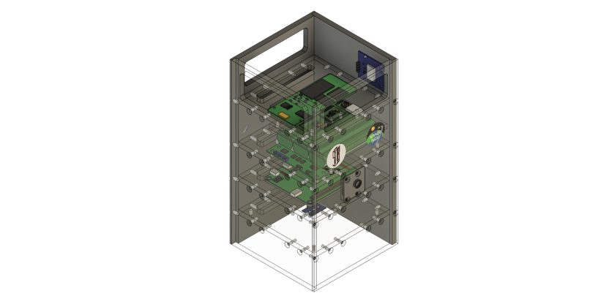
STR
Introduction
Al 6061 material
Manufactured by German Datron NEO+ digital processing machine
Fusion 360 modeling, tool path design

Slide 9
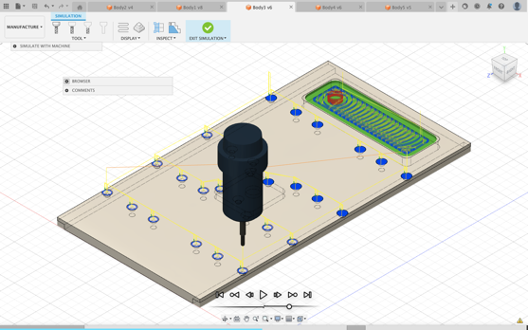
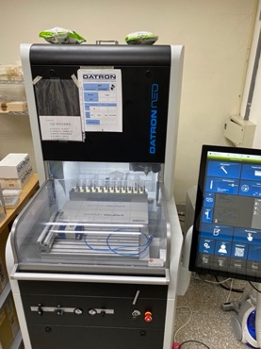

Slide 10
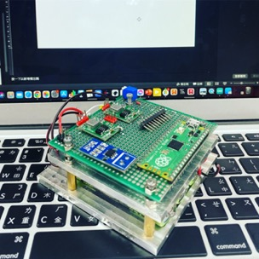
EPS
Introduction
18650 battery+TP4056
Hand-made power distribution board with PCB board
Supply power to whole satellite

Slide 11
03
Payload & GPS

Slide 12
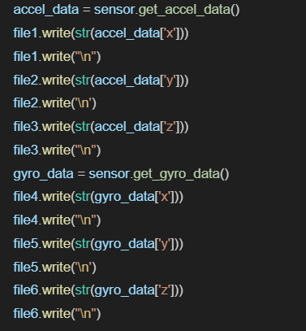
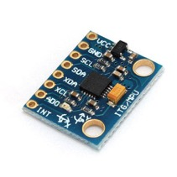
Payload-MPU6050
Introduction
Measures three-axis acceleration and angular velocity data.

Slide 13
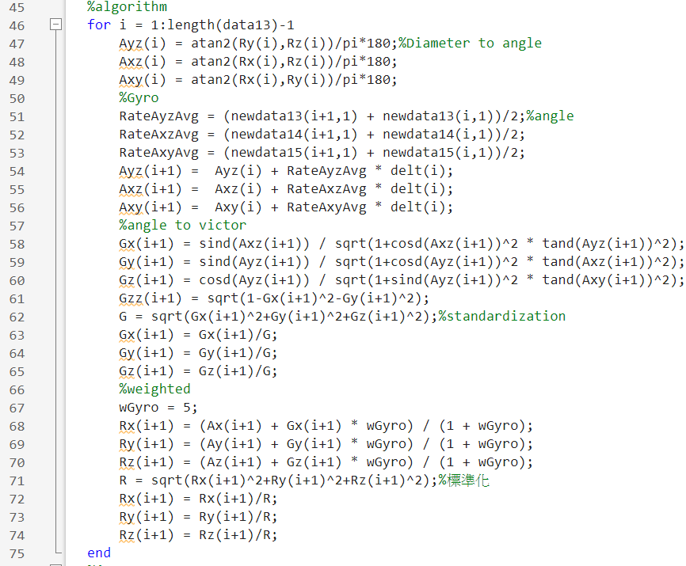
Payload-MPU6050
Data processing
Obtain the CubeSat's three-axis attitude angles over time.

Slide 14
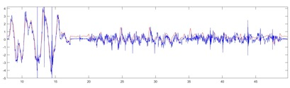
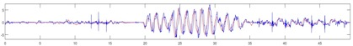
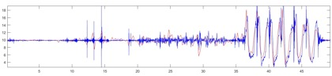
Payload-MPU6050
X axis accelerometer comparison
Y axis accelerometer comparison
Z axis accelerometer comparison
Comparison

Slide 15
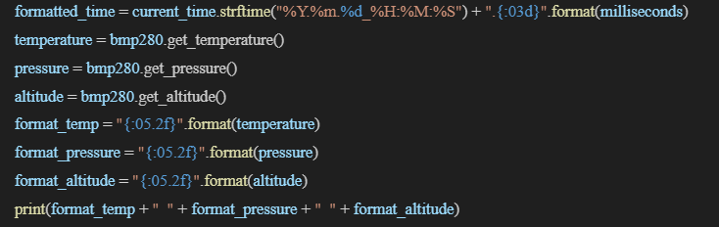
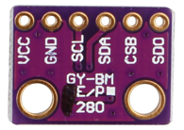
Payload-BMP280
Introduction
Measures barometric pressure and temperature data, and calculates relative altitude changes based on pressure variations.

Slide 16
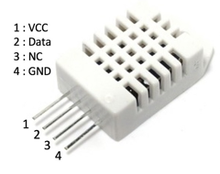
Payload-DHT22
Introduction
Measures temperature and humidity data.

Slide 17
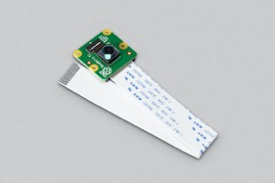
Payload-Pi Camera
Introduction
The Pi Camera will record external images during satellite flight, , with each image lasting for one minute.
Camera Resolution: 1920*1080
camera.resolution = (1280,720)
#camera.rotation = 180
# delete exist video
video_file = 'video'+str(i)+'.h264'
if os.path.exists(video_file):
renamed_file = 'video'+str(i)+'.old'
os.remove(video_file, renamed_file)
# save to file(video)
camera.start_recording('/home/user/video'+str(i)+'.h264')
time.sleep(60)
camera.stop_recording()

Slide 18
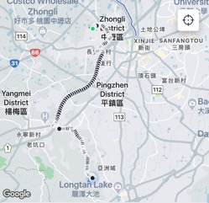
Payload-NEO-6m GPS Tracker (GPS1)
Introduction
This module will provide real-time satellite location information and assist us in retrieving the SD card after the satellite lands.

Slide 19
04
OBC

Slide 20
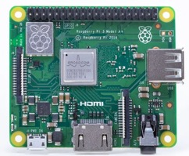
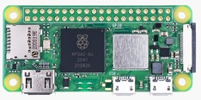
On-board computer
Introduction
Consists of two parts, Raspberry Pi 3 Model A+ and Raspberry Pi Zero 2W.
Raspberry Pi 3 Model A+ capturing images using the Raspberry Pi Camera
Raspberry Pi Zero 2W handles other sensors

Slide 21
On-board computer
Program
On the Raspberry Pi Zero 2W, three programs will be automatically executed:
gpspress_print.py: Reads GPS longitude, latitude, and altitude, along with barometric, temperature and humidity data.
gpsprint.py: Only reads GPS longitude and latitude in case altitude data is missing.
mpu6050_raw.py: Reads three-axis acceleration and angular velocity data.
On the Raspberry Pi 3 Model A+, the program "camera.py" will be automatically executed.
camera.py: Record videos after startup, until the satellite loses power, and it will save a file every minute

Slide 22
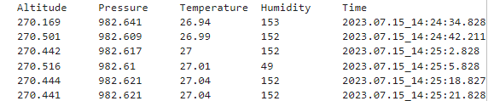
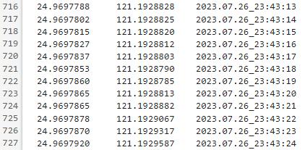
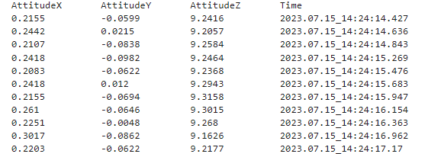
On-board computer
Data Processing
Bmp280 data
NEO-6m GPS data
Mpu6050 data

Slide 23
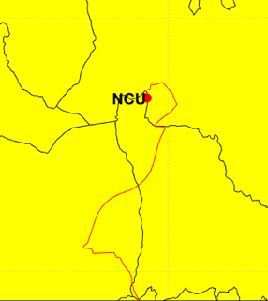
On-board computer
Data Processing
GPS mapping

Slide 24
Thank for listening
感謝聆聽

